Slide 1
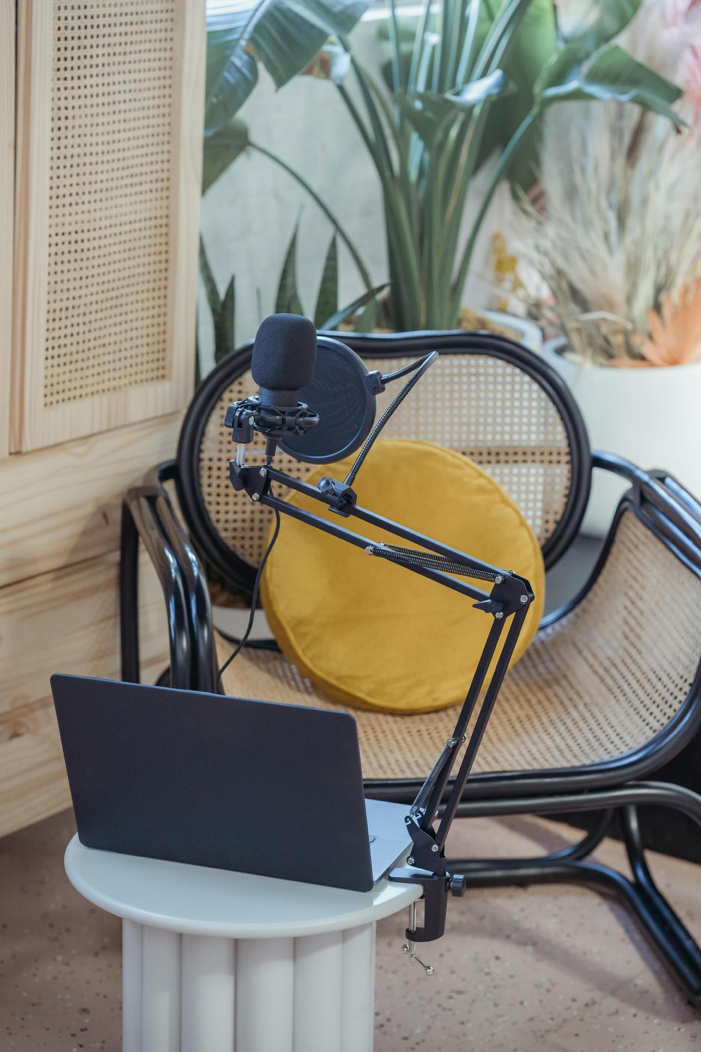
Guide to podcasting
Podcasting as training material
Getting started
Pre-production
Recording
Editing
Publishing
Disseminating
Lucy Sabin, Amsterdam UMC, November 2024
With thanks to Samborne Bush, University of Sheffield, August 2024

Slide 2
Podcasting as training material
Podcasts offer effective methods of communication for research and education
Strengthened transdisciplinary relationships through dialogue
Storytelling a way to connect, reflect, share learning and build a sense of community
Sound is immersive and can engage audiences on an emotional and imaginative level
Podcasts are especially useful when supplementing other forms of dissemination
You can also re-use podcast audio (for example in an online module or as audio for a short film)
See Interesting literature on podcasting

Slide 3
Podcasting as training material
Benefits​
Geographic reach
Cost-effective
Engaging​ & immersive
Space for storytelling​ & complex scenarios
Multi-purpose​ & intertextual
Diverse voices
Limitations​
Accessibility ​– we will always use a transcript with time codes & can produce accompanying visual content
'Digital divide' – but members of our training target groups are working age and already consume digital media

Slide 4

Nos futurs radio
by Le Biais Vert
@Naturarchy exhibition iMAL, Brussels 2024

Slide 5

Getting started
Physical:
Microphone
USB vs XLR (needs mixer)
USB, Blue Yeti (€110)
Headphones
Laptop
Editing Software
Guests
Theoretical:
Series theme
Episode themes (sub-categories)

Slide 6
Pre-production
Once you’ve sorted the equipment and have an idea for a series, there’s a couple more things to think through:
Episode storyboarding
GDPR data guidelines (consent forms, ‘licensing’ of voices)
Compensation for guests*
*Monetary compensation is not something we would necessarily offer with RE4GREEN. Instead, we could co-develop episode themes with guests so the discussion benefits them professionally. We would build ongoing relationships and community.

Slide 7
Recording tips
Get to know the equipment and audio editing software before the interview. It’s very useful to learn about audio ‘gain’, directional recording (depending on the microphone), and how to record at the right levels before you record an interview.
Audio can be fixed in post, but it’ll always be better quality the closest you can get to ‘perfect’ in the recording
Tips: Small, quiet room, turn ‘gain’ down as low as you can, speak loudly and clearly towards the mic

Slide 8
Editing
Essential skills
Cutting and pasting
Fade in/out
Noise reductions
Sound normalisation
‘Ducking’ audio (auto-duck)
Other useful skills:
Bass and treble editing
Changing speed, tempo, pitch
Software
Audacity (free software)
Sound design
Field recording (iPhone)
Open source sound library (freesound.org)
Music production (Abby Litchfield)

Slide 9

Publishing
To publish a podcast, you need to find a place to ‘host’ it.
You use an ‘RSS’ feed to upload across all platforms:
Podbean
Buzzsprout
Acast
Spotify for Podcasters
We would also create a landing page (Embassy):
Direct to website
Transcript (could use free ‘Riverside FM AI Transcription’
Headshots and additional photos / media content
Increase engagement

Slide 10

Disseminating
Produce social media content to promote each episode (e.g., audiograms)
Feature new episodes via Embassy Newsletter
Share episodes across our network – actively (e.g., LinkedIn reposts) and passively (e.g., in email signatures)
Invite podcast guests to actively share among their networks and incorporate episodes in their curricula
Use within training programs on Embassy and elsewhere
Physical presence at events – QR codes, installations

